Slide 1
National Network of Fusion Centers
Real-time Open Source Analysis
Threat to Life Reporting & Coordination
Mike Sena, President
Alberto Martinez, Secretary

Slide 2
National Network of Fusion Centers
State/Territorial Fusion Center
Major Urban Area Fusion Center
Governor designated & Federally recognized
www.NFCAUSA.org

Slide 3
Real-time open source analysis (ROSA)

Slide 4
Current Landscape

Slide 5
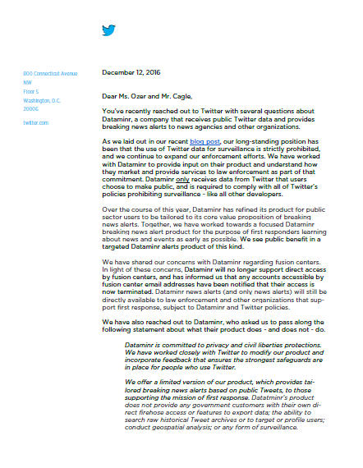
Real-time Open Source Analysis (ROSA)
Resource Guide developed to:
Assist agencies and fusion centers in understanding the lawful and appropriate use of open source information, focusing on social media

Slide 6
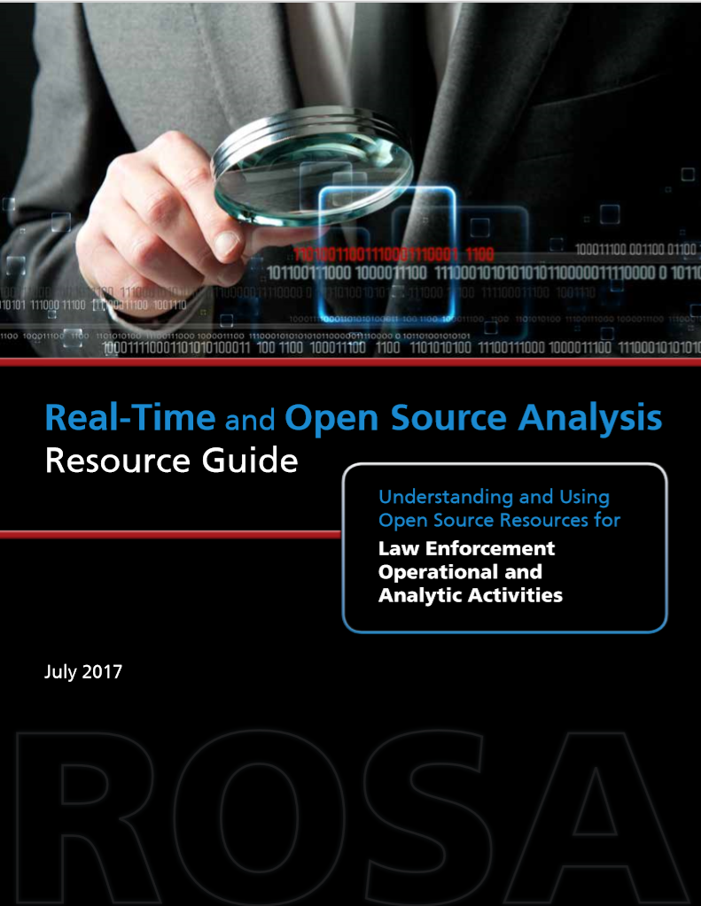
Real-time Open Source Analysis (ROSA)
Resource Guide developed by:
The National Network of Fusion Centers
DHS
FBI
Office of the Director of National Intelligence (ODNI)
Associations represented on the Criminal Intelligence Coordinating Council (CICC).

Slide 7
Real-time Open Source Analysis (ROSA)
Resource Guide designed to:
Help law enforcement understand the potential tools and resources available to support law enforcement operational and analytic activities
Ensure that related privacy, civil rights, civil liberties (P/CRCL) concerns are addressed

Slide 8
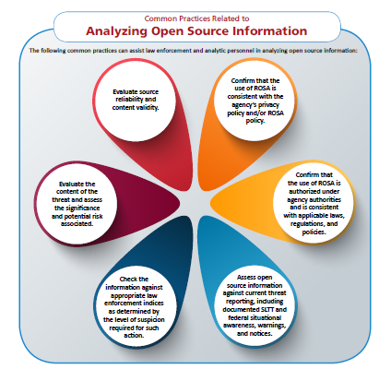

Slide 9
How Is ROSA Used?
Develop or enhance criminal intelligence (including situational awareness reports),
Support Criminal/terrorism analysis and criminal intelligence development,
Suspicious activity reporting (SAR) analysis
Identify public safety risks either past, present, or anticipated

Slide 10
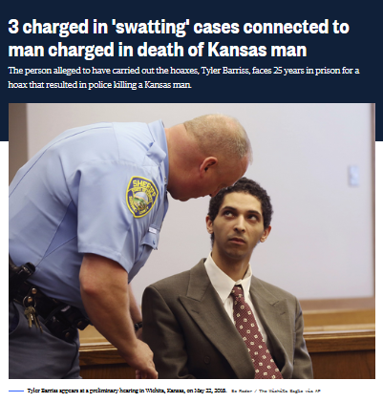
Criminal Investigative Support
ROSA may be used to identify criminal suspects, evidence pertinent to a criminal investigation, and possible witnesses of a criminal act and other criminal-related activities

Slide 11
Threat to life

Slide 12
Threat to Life Reporting
Social Media Threats & Public Safety – The Problem & Potential Path Forward
Criminals, terrorists, extremists, aspiring mass casualty attackers, & foreign intelligence services use social media to engage in illegal activities and spread fear

Slide 13
Who Can Intervene?
The public, social media platform companies, private sector partners, and public safety organizations all have a role

Slide 14
Resources Available
NATIONWIDE SUSPICIOUS ACTIVITY REPORTING INITIATIVE (NSI)
HOMELAND SECURITY INFORMATION NETWORK (HSIN)
NATIONWIDE DECONFLICTION SYSTEMS
DUTY-TO-WARN

Slide 15
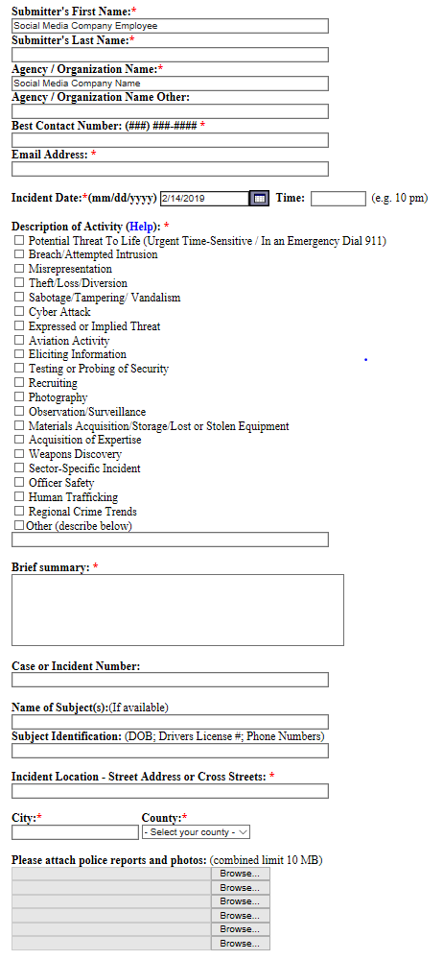
Threat to Life Reporting
NATIONWIDE SUSPICIOUS ACTIVITY REPORTING INITIATIVE (NSI)

Slide 16
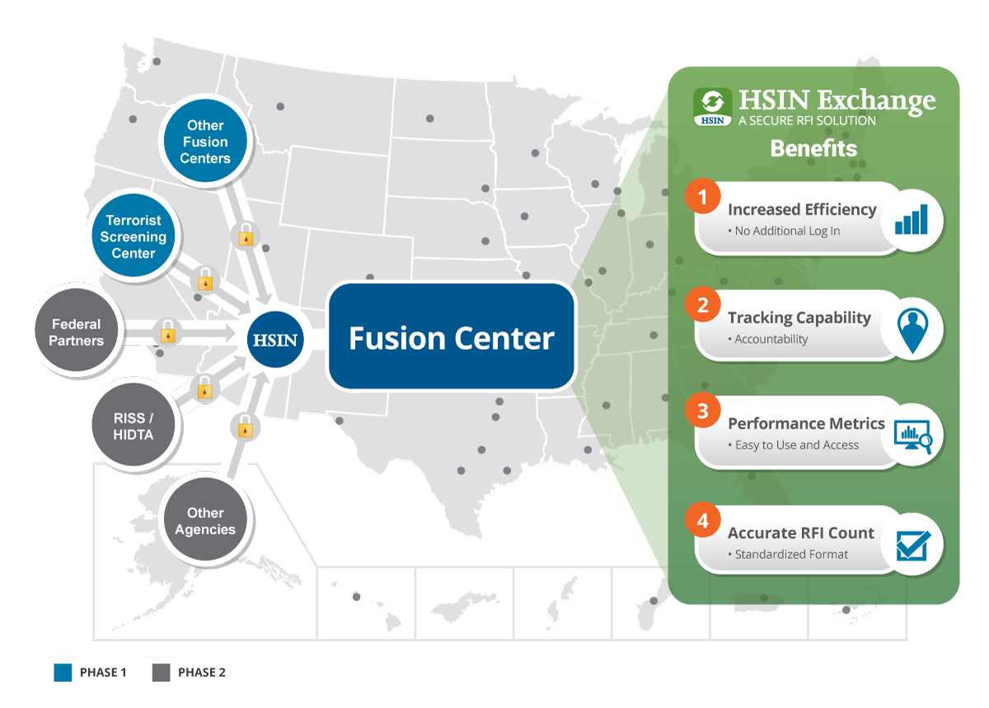
HOMELAND SECURITY INFORMATION NETWORK (HSIN)

Slide 17
Threat to Life Reporting

Slide 18
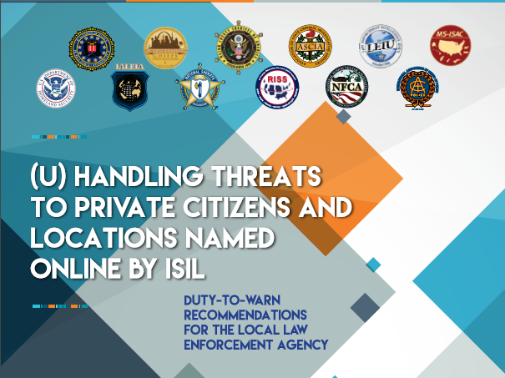

Slide 19
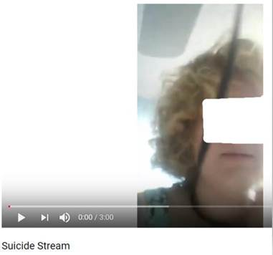
Threat to Life Reporting
Developing consistent planning, data collection, processing, analytic production, dissemination and feedback loops.
12/09/18, video was uploaded to a social media company’s livestreaming platform showing a minor putting a cord tied to a fan around her neck.
The company reported the event through the SAR platform to a fusion center in CA
The CA fusion center identified the location of the minor & notified a fusion center in FL who contacted local LE who took the minor into protective custody

Slide 20
Threat to Life Reporting
January 23, 2019, 2:26 PM: A social media company a video titled “My death of suicide no choice” to a fusion center in CA.
January 23, 2019 3:04 PM: The report was transferred to the Tennessee Fusion Center (TFC) after initial triage.
January 23, 2019, 3:31 PM: The CA fusion center updated the TFC with the potential identity and location information for the at risk person. TFC coordinated with the local LE agency and the subject was taken into protective custody.

Slide 21
Questions ???

